Slide 1

SYNOPTIC GOSPELS
Matthew, Mark and Luke

Slide 2
SYNOPTIC GOSPELS
Gospel ~ from Old English gōdspel – gōd (good) spel (tale)
euangelion ~ good message
Synoptic ~ sun (with) + optikos (noun form of to see)
Matthew, Mark and Luke

Slide 3
SYNOPTIC GOSPELS
Matthew
King
Mark
Servant
Luke
Man
John
God
Matthew, Mark and Luke

Slide 4
SYNOPTIC GOSPELS
Two genealogies:
Matthew 1.1-16 ~ Legal right through Joseph to David
Through Solomon
Luke 3.23-38 ~ Hereditary right through Mary to David
Through Nathan (all the back to Adam)
Matthew, Mark and Luke

Slide 5
SYNOPTIC GOSPELS
Matthew shows Jesus as the Promised Messiah
Luke shows Jesus as the Perfect Man (last Adam, 1 Cor. 15:45)
Matthew, Mark and Luke

Slide 6
SYNOPTIC GOSPELS
Key word in Mark is immediately (straightforward) ~ euthus
42 of 80x in Mark
Matthew, Mark and Luke

Slide 7
SYNOPTIC GOSPELS
Stones into bread ~ the tempta-tion of the body
The pinnacle of the Temple ~ the temptation of the soul
To bow before Satan ~ the temptation of the spirit
Matthew, Mark and Luke

Slide 8
SYNOPTIC GOSPELS
Watched ~ paratēreō – to watch over intensely
Matthew, Mark and Luke

Slide 9
SYNOPTIC GOSPELS
Mark 3:5 ~ And when He had looked around at them with anger…
Matthew, Mark and Luke

Slide 10
SYNOPTIC GOSPELS
Filled with rage ~ anoia, literally, without mind
KJV, madness
Matthew, Mark and Luke

Slide 11
SYNOPTIC GOSPELS
“The new law requires you to keep perpetual Sabbath, and you, because you are idle for one day, suppose you are pious … The Lord God does not take pleasure in such observances, if
there is any perjured person or
thief among you, let him cease to
be so; if any adulterer, let him
repent; then he has kept the sweet
and true sabbaths of God. If
any one has impure hands, let
him wash and be pure.” – Justin
Martyr, Dialogues 12.3
Matthew, Mark and Luke

Slide 12
SYNOPTIC GOSPELS
Law is the O.T. standard (613 precepts)
365 negative; 248 positive
Sermon on the Mount is N.T. standard
O.T. says, "Do" (Do-attitudes); N.T. says, "Be" (Be-attitudes)
Matthew, Mark and Luke

Slide 13
SYNOPTIC GOSPELS
Parables ~ para (alongside) + ballō (to throw) – an earthly story with a heavenly meaning
Matthew, Mark and Luke

Slide 14
SYNOPTIC GOSPELS
1st understand ~ eidō – compre-hend intuitively
2nd understand ~ ginōskō – compre-hend by experience
Matthew, Mark and Luke

Slide 15
SYNOPTIC GOSPELS
Tribulation ~ thlispis – from root meaning “pressure”
Matthew, Mark and Luke

Slide 16
SYNOPTIC GOSPELS
Three things that rip us off:
1. The devil (hard ground)
2. The flesh (stony ground)
3. The world (thorny ground)
Matthew, Mark and Luke

Slide 17
SYNOPTIC GOSPELS
Calvary
Pilate’s Quarters
Gethsemane
Council Chambers
Herod’s Palace
Last Supper
From the “Upper Room” to “Calvary”
Annas (Jn. 18:18-24)
Caiaphas (Matt. 26:57-68)
Pilate (Mark 15:2-5)
Herod (Lu. 23:6-12)
Pilate (Matt. 27:15-30)
Matthew, Mark and Luke

Slide 18
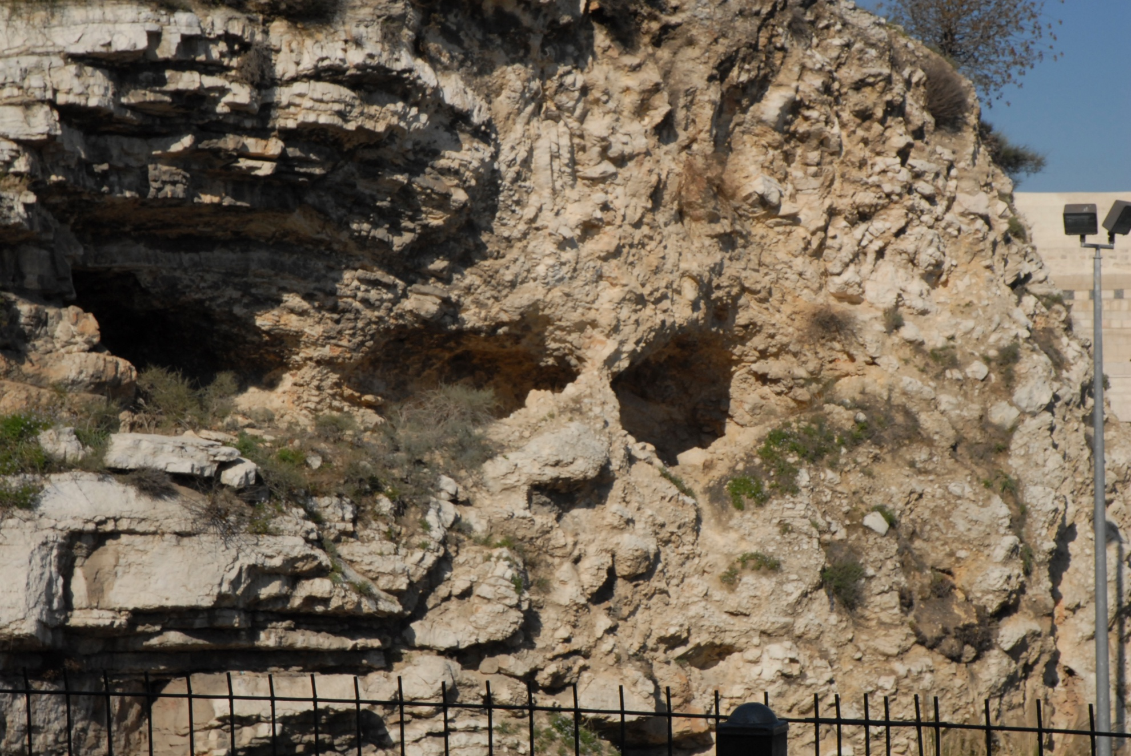
SYNOPTIC GOSPELS
“The Place of the Skull”
Matthew, Mark and Luke

Slide 19
SYNOPTIC GOSPELS
Hab. 1:13 ~ You are of purer eyes than to behold evil,
And cannot look on wickedness.
1 Cor. 5:21 ~ For He made Him who knew no sin to be sin for us, that we might become the righteousness of God in Him.
Matthew, Mark and Luke

Slide 20
SYNOPTIC GOSPELS
Hogwashizomai
Matthew, Mark and Luke

